Slide 1
ANALYSIS OF CUSTOMER’S
TRANSACTION
SATYAM KARDE

Slide 2
PROBLEM STATEMENT
To inspect and perform Machine Learning operations on the dataset to derive relevant data driven solution based on the outcomes presented. The dataset to be used for this task is named as “Copy of customer_transactions_sample.xlsx.”

Slide 3

INITIAL STEPS
We need to convert the xlsx file to a csv file so that we can analyze the data by importing it from the google drive and loading it on the google colab platform. The steps to load the csv file onto the google colab is given as follows:-

Slide 4
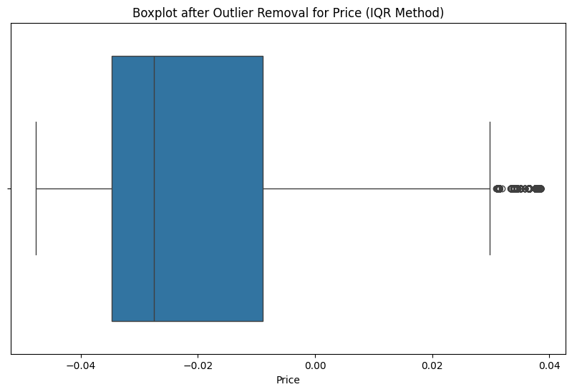
DATA PREPROCESSING
The main goal of the data preprocessing process is to identify the null values, duplicate value and Identifying,handling of outliers. This ensures that the data is able to deliver good results. We have handled the outliers as follow:-

Slide 5
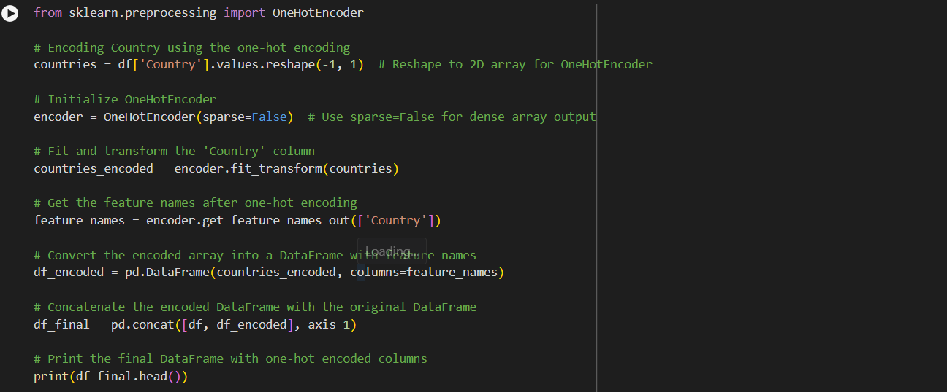
ENCODING
Encoding for certain attributes are important since some of them may have categorical data. I used one-hot encoding to convert the ‘Country’ attribute to a numerical data. The steps I used to do this is given as follow:-

Slide 6
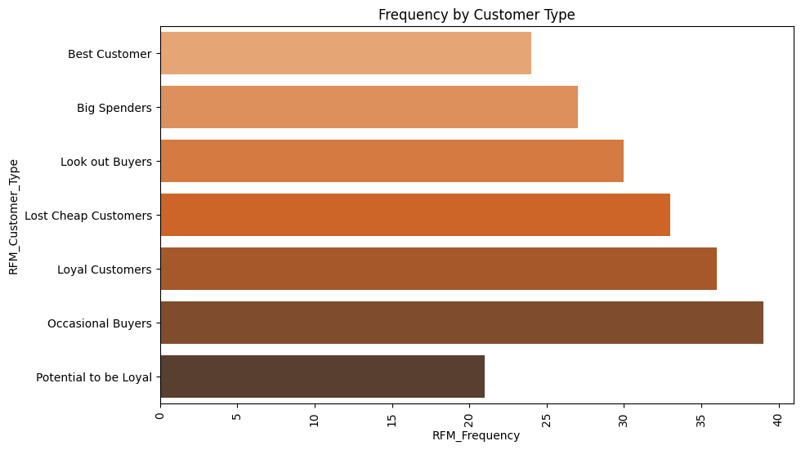
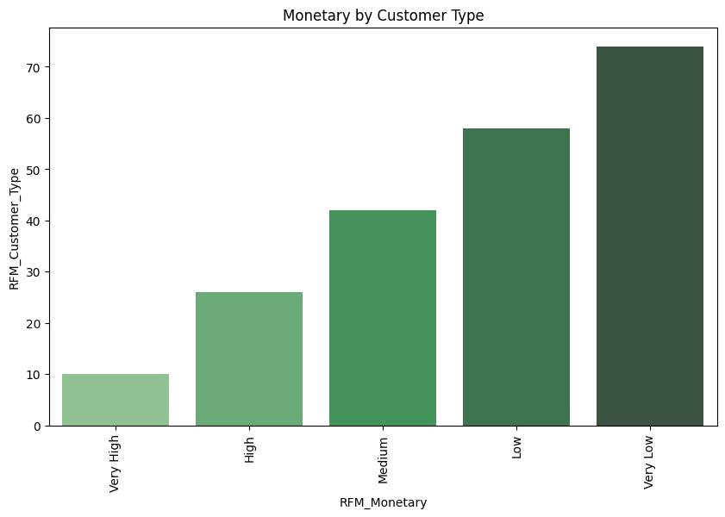
CLUSTERING FOR MARKETING
We were task to analyze the data to derive possible solutions for marketing purposes. We were asked to find recency, frequency and monetary features to analyze the pattern. We were able to visualize this as follow:-

Slide 7
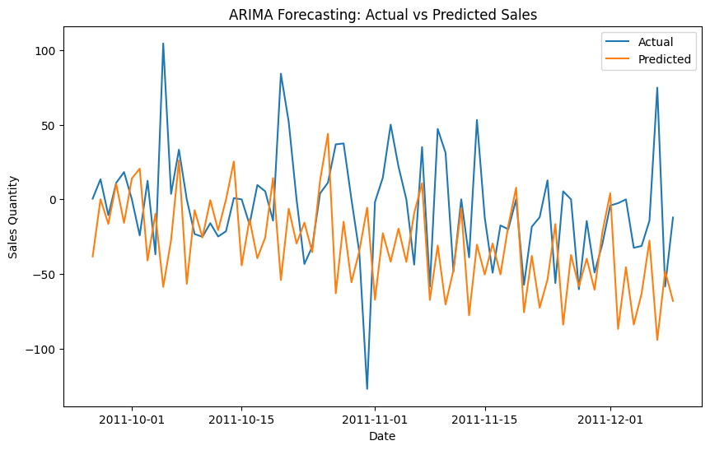
FORECASTING FOR SALES AND OPERATION
For the purpose of forecasting, we used ARIMA model. It is a very effective forecasting model and therefore we used it for our purpose. We were able to visualize this as follows:-

Slide 8
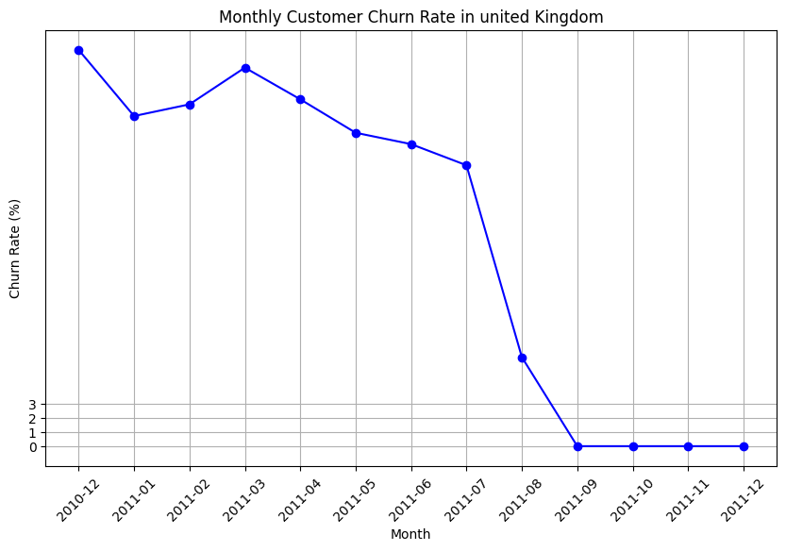
ESTIMATING CHURN RATE
We estimated churn rate by using using recency, frequency and monetary attribute. Also we have have estimated churn rate by using the time-duration within a country. We have used United Kingdom as an example. We visualize this as follow:-

Slide 9
POSSIBLE INSIGHTS FROM THE ML OPERATIONS
Customer Segmentation:- We were able to differentiate between various customer based upon their behaviour based on recency, frequency and monetary features. This helps when we want to create new marketing strategies based on various customer base.
Sales Forecasting:- We were to forecast future sales based on the historical patterns detected.
Customer Behaviour:- We were able to understand the overall customer behaviour which again helps companies to focus their services according to the patterns of customers.
Churn Rate Analysis:- By Evaluating churn rate, Businesses can evaluate and formulate plans to lower the overall churn rate to maximize revenue.
Financial Health:- Due to the ARIMA analysis, we can estimate the overall financial health of the business.

